Slide 1
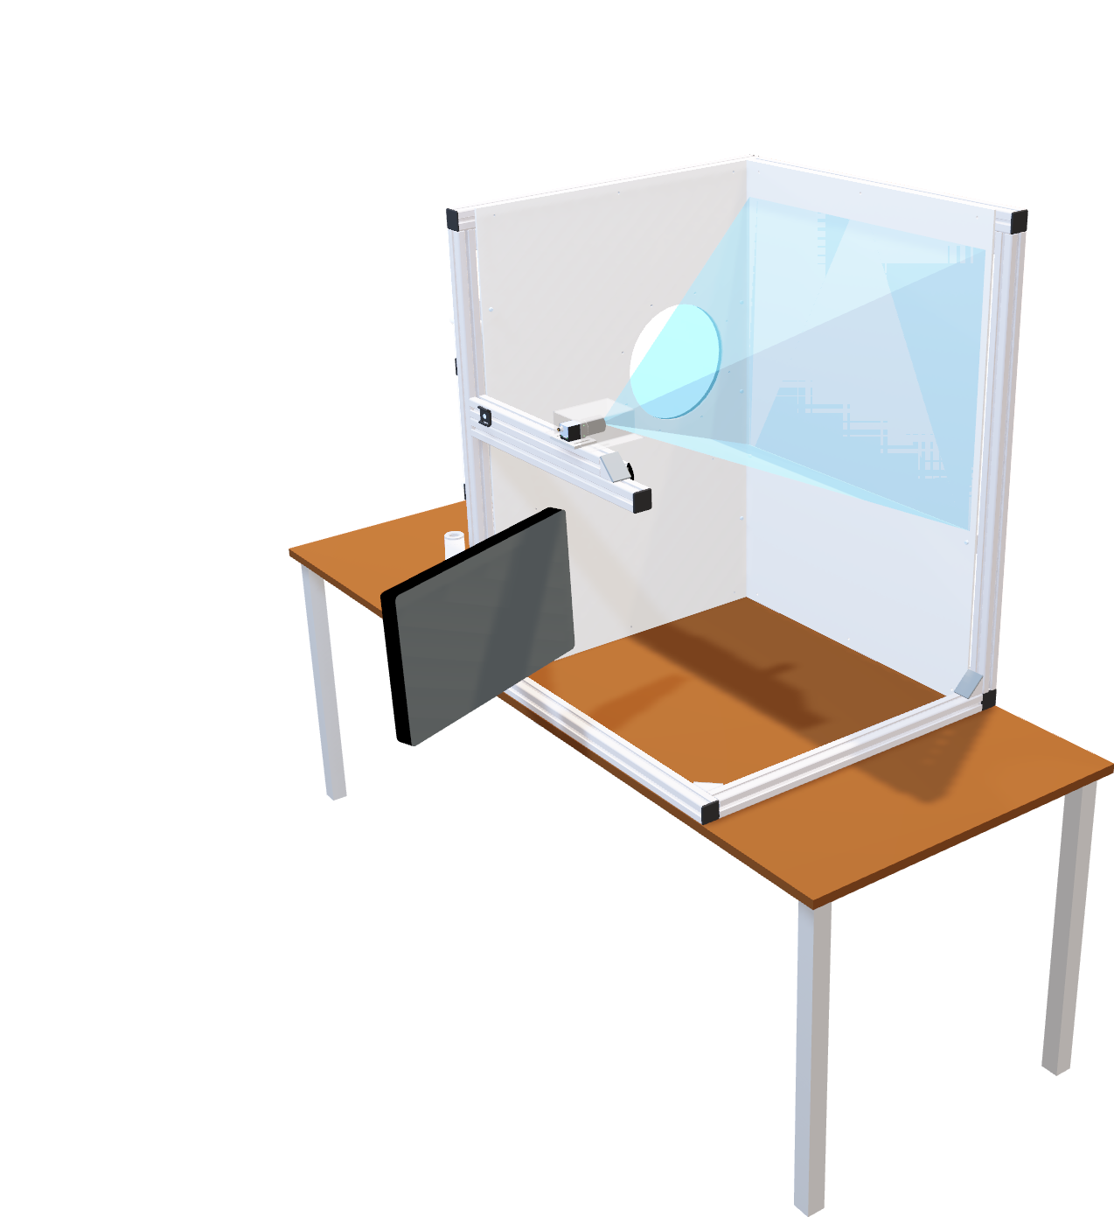

AI High-Performance Solution on FPGA
by Nico Canzani and Dominik Müller

Slide 2
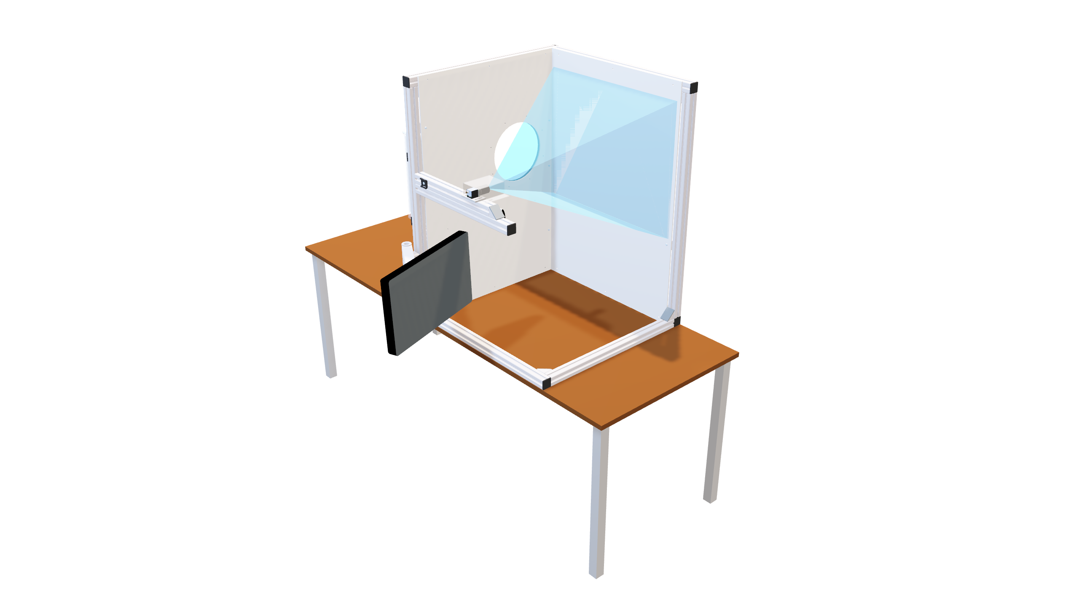


Slide 3
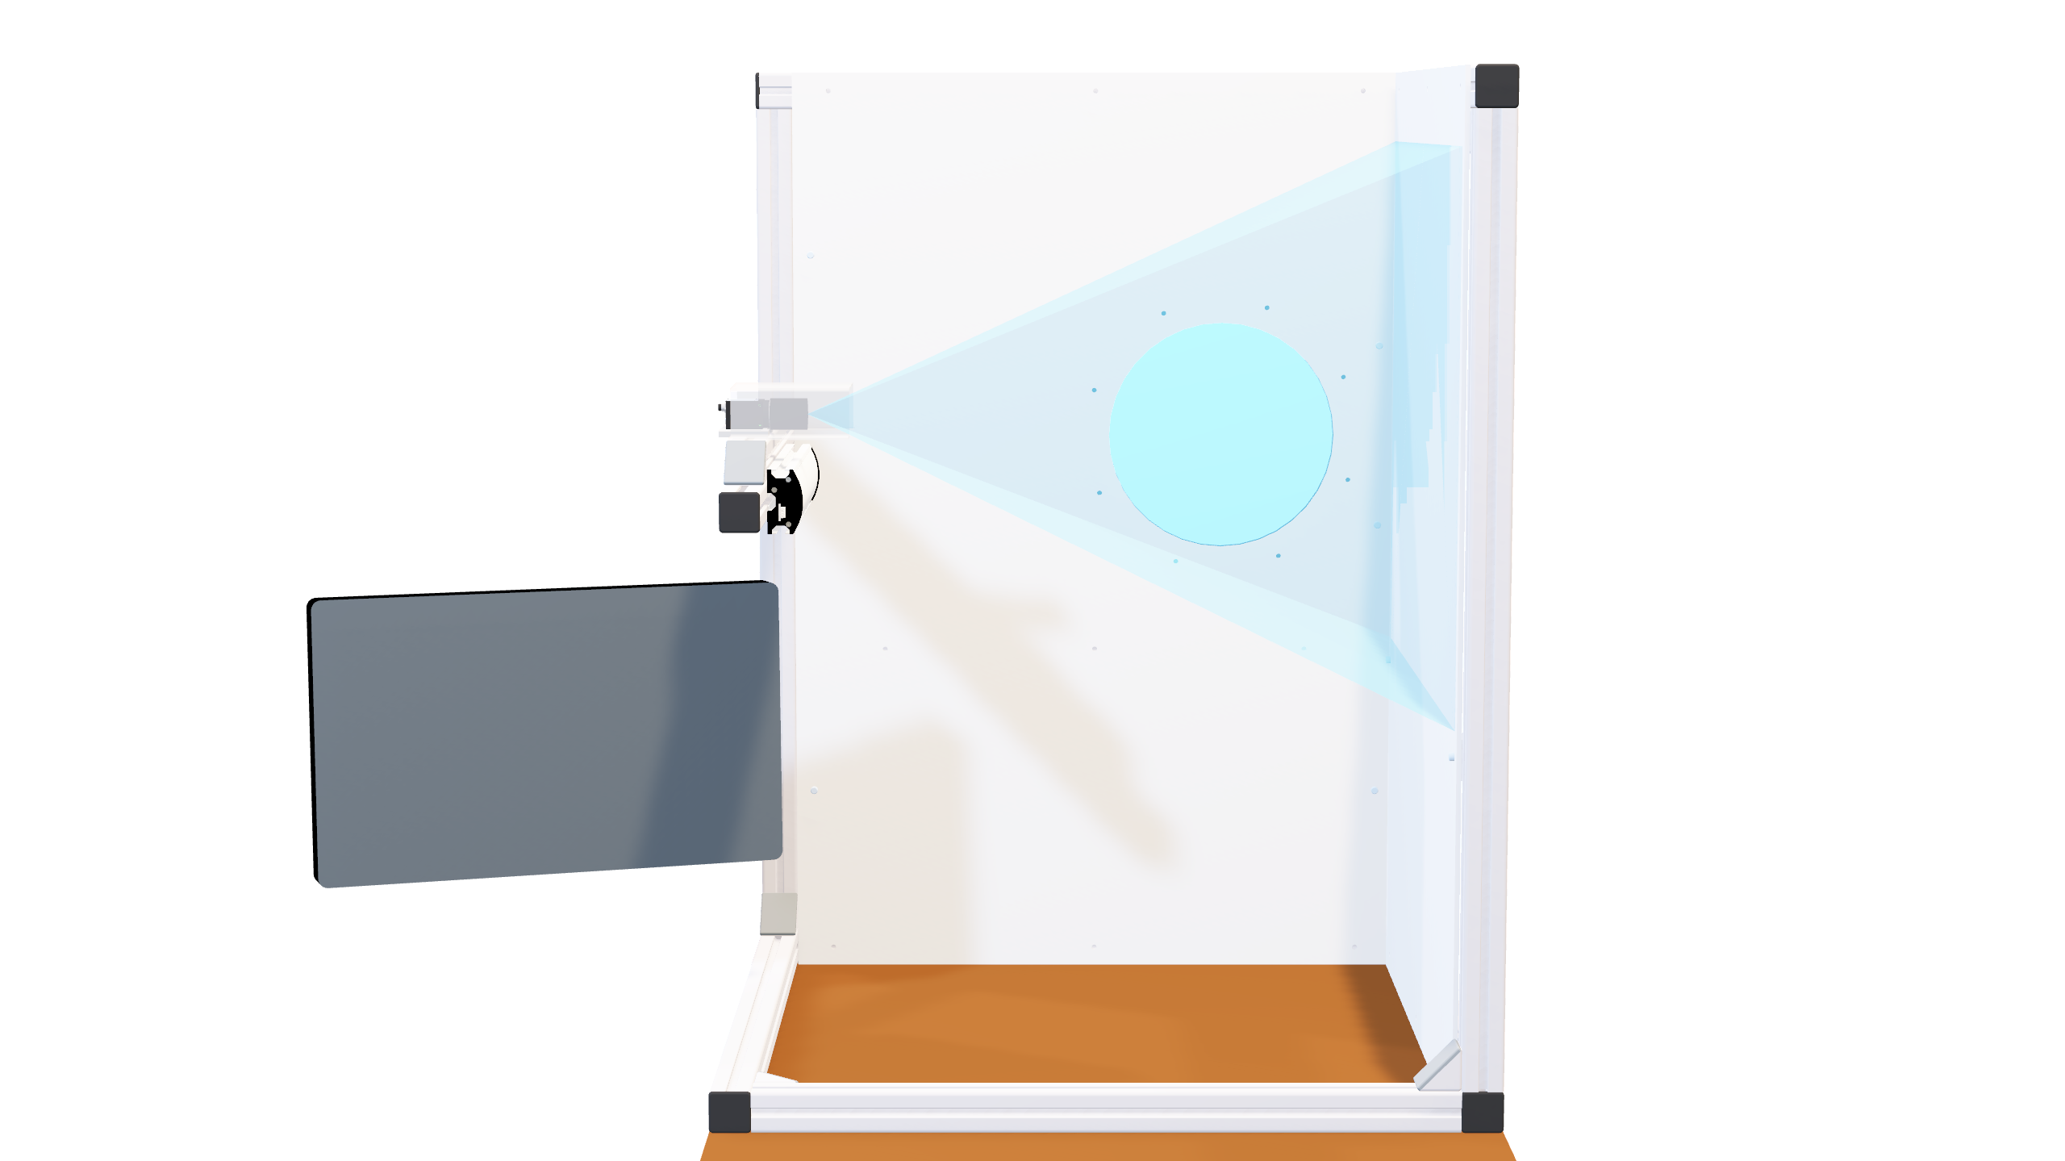


Slide 4
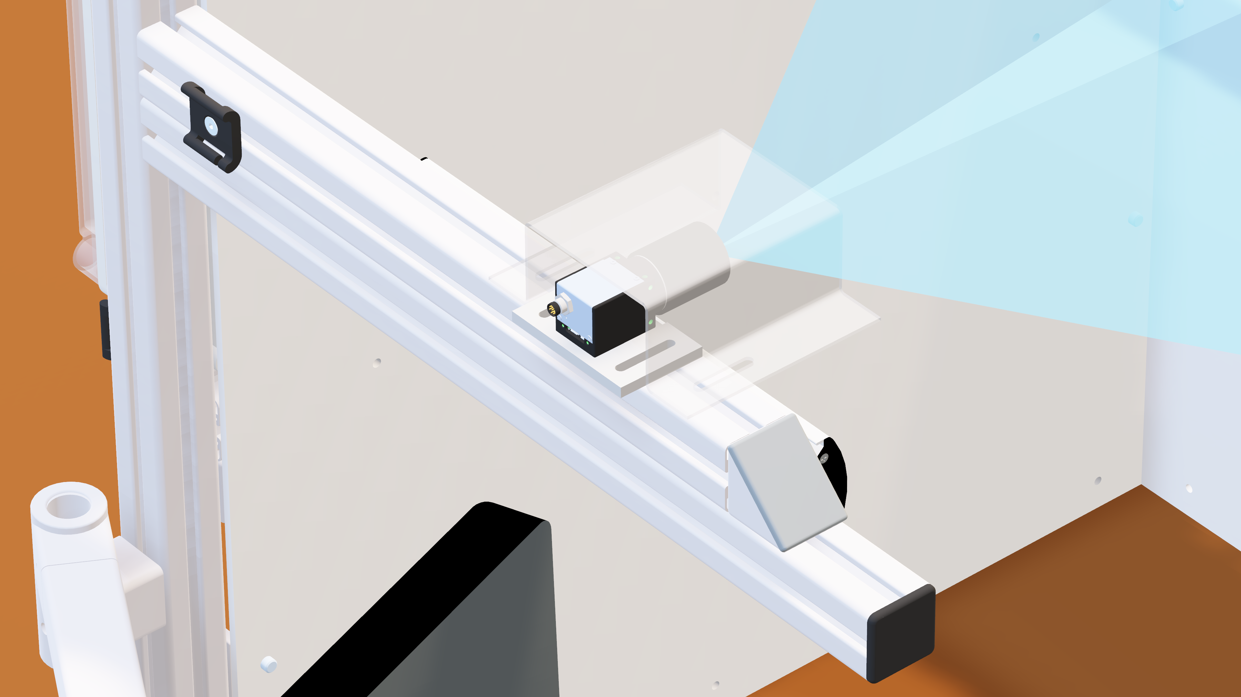

Cable Clips
Camera Protection
Camera Holder

Slide 5
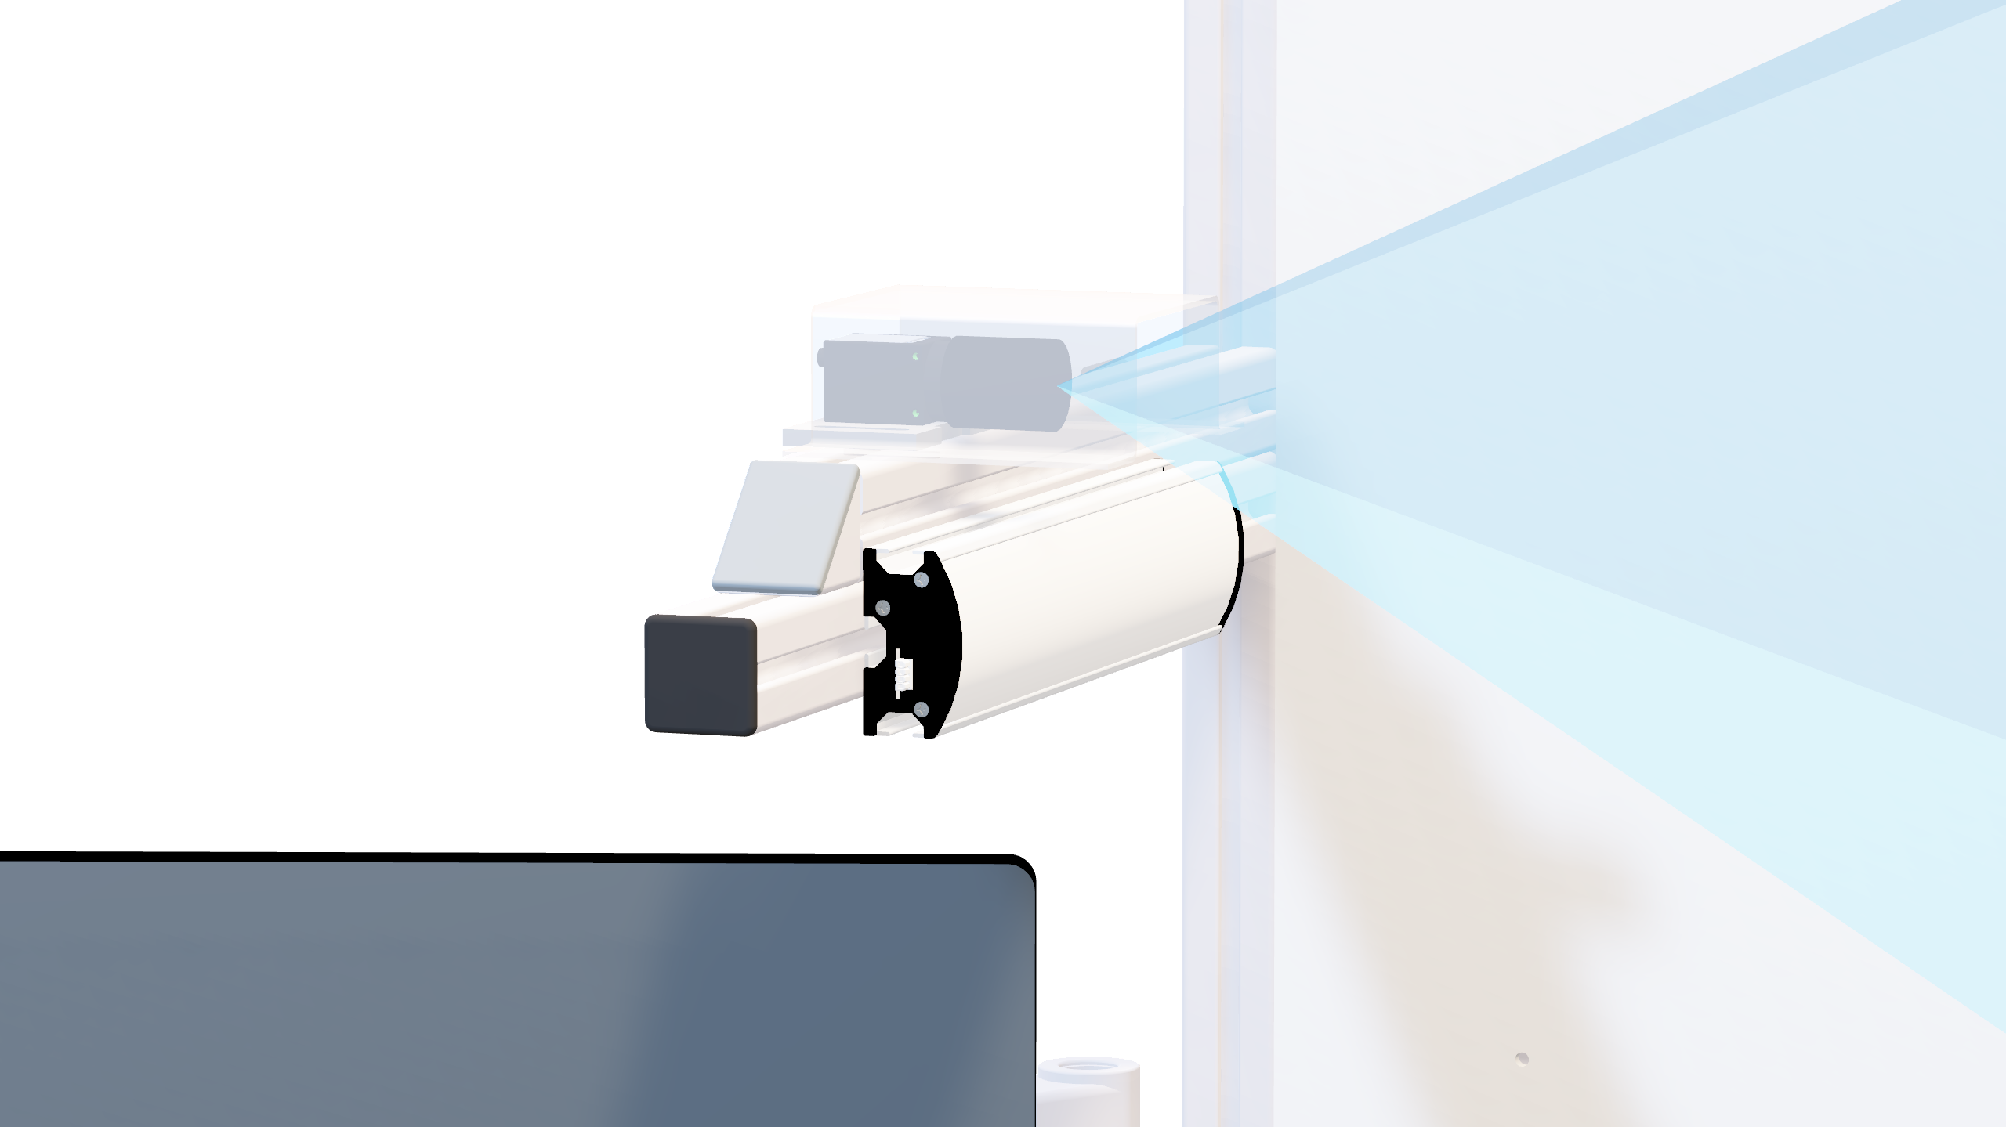

Diffuse Lighting

Slide 6
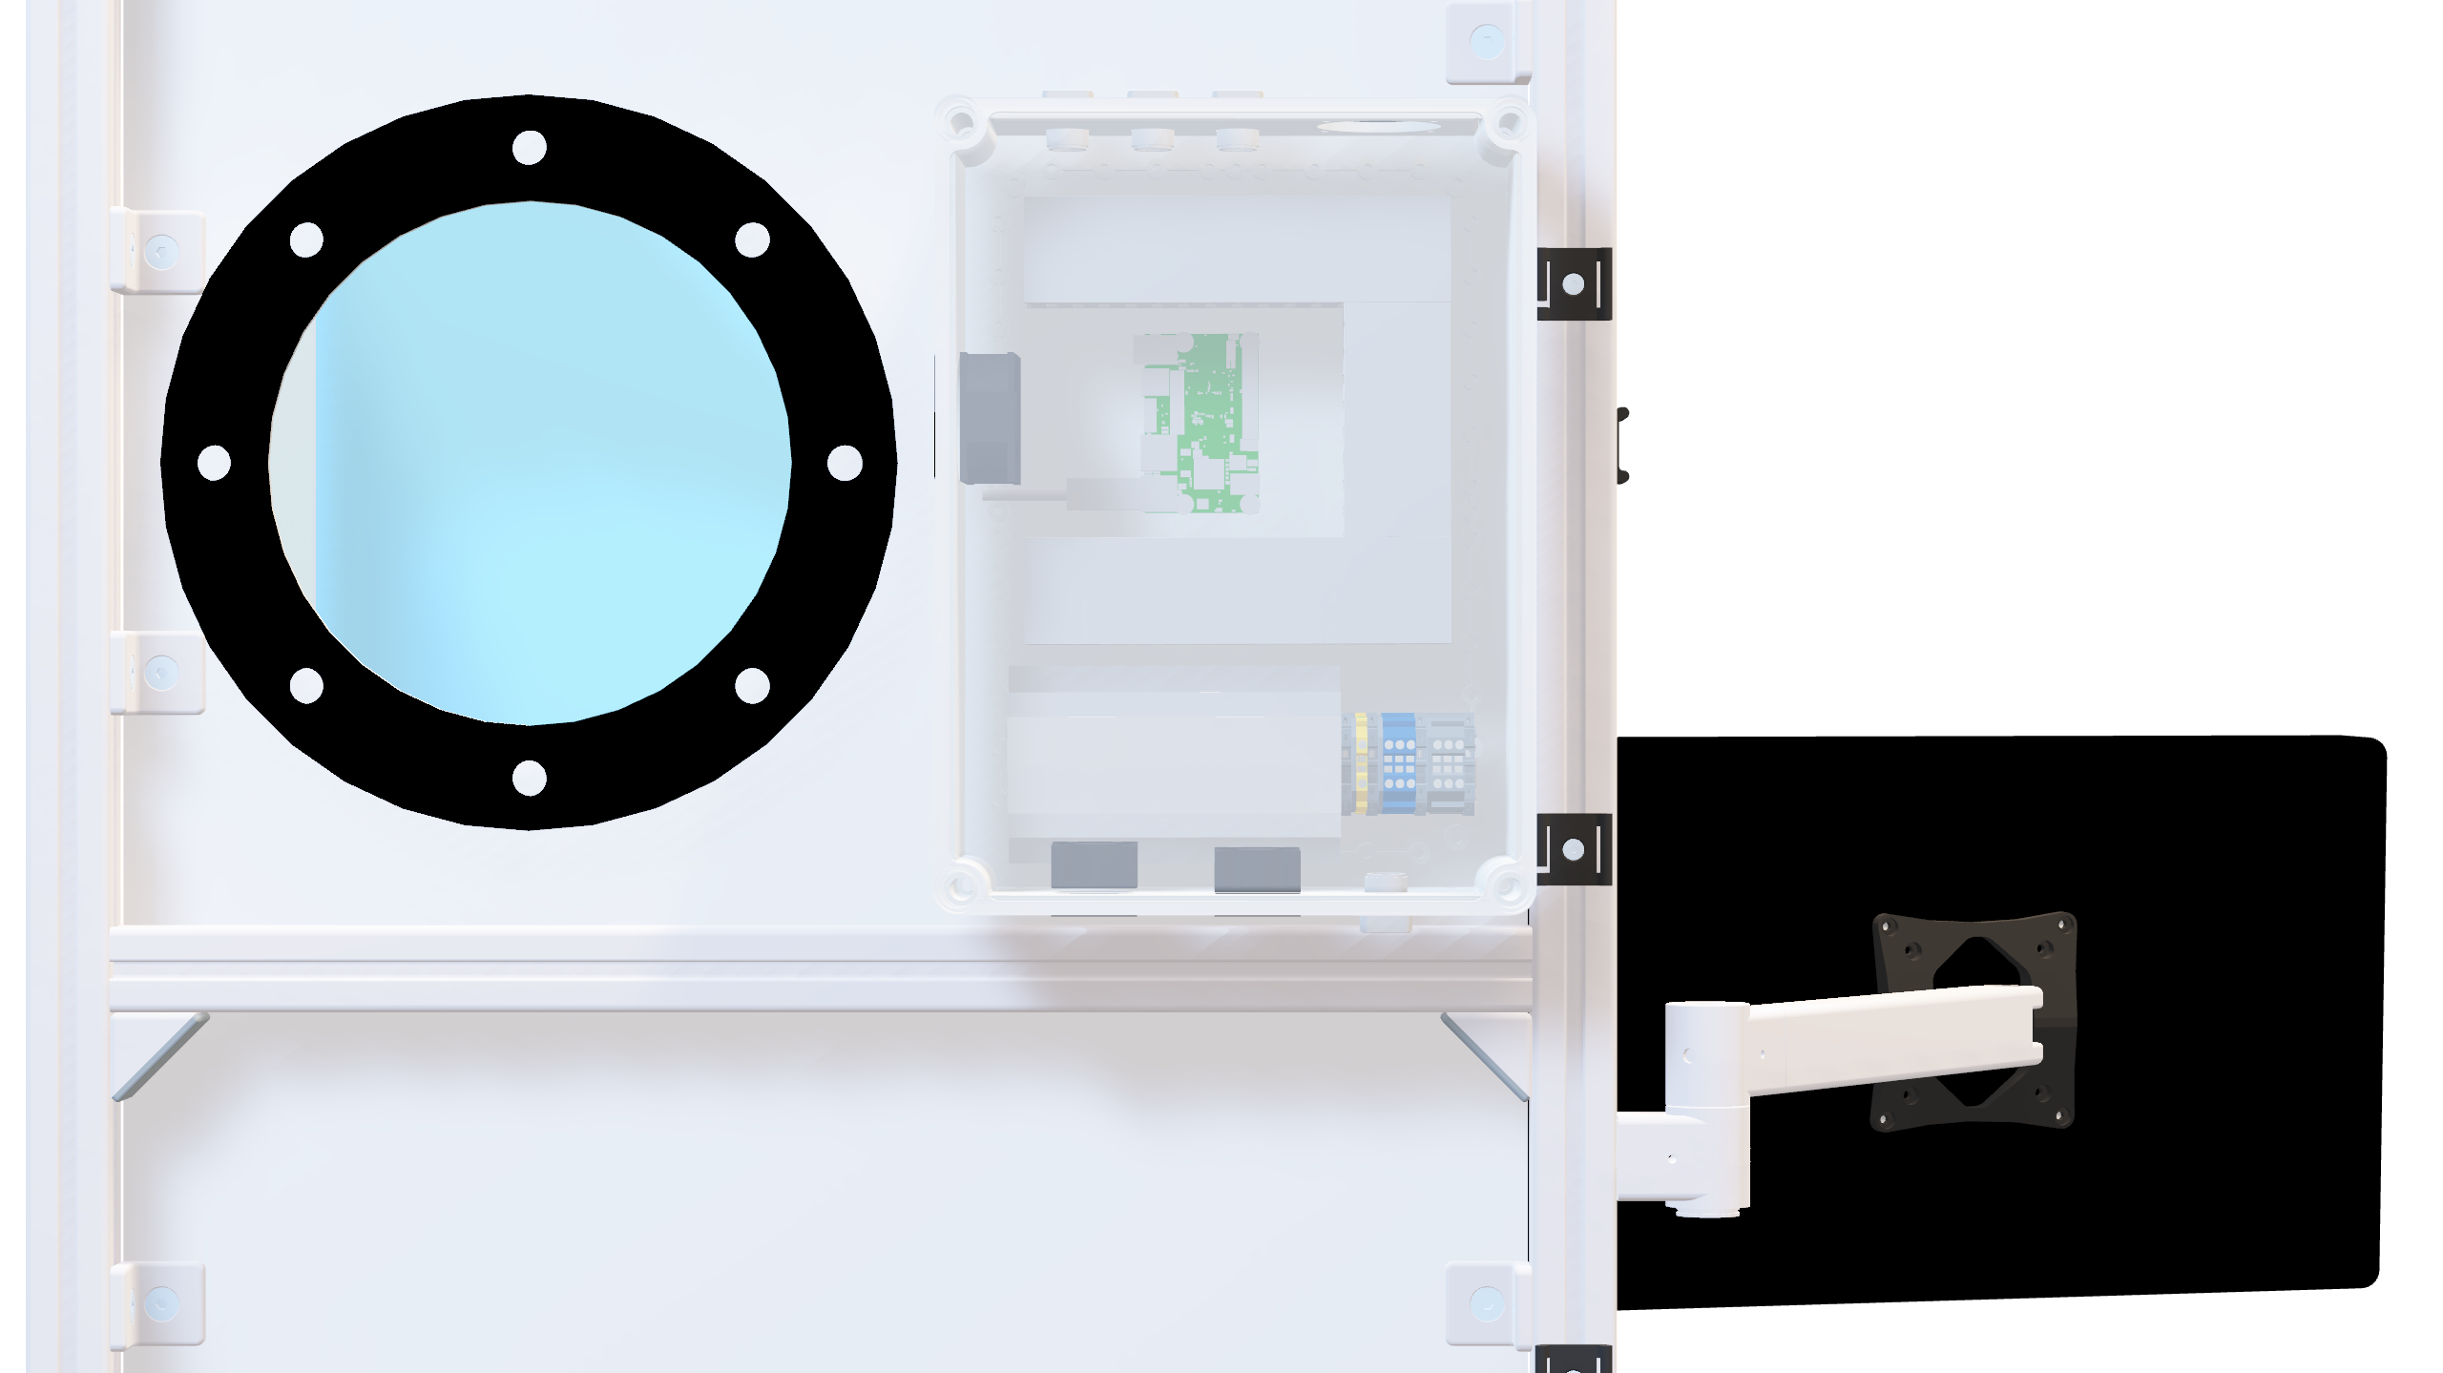


Slide 7
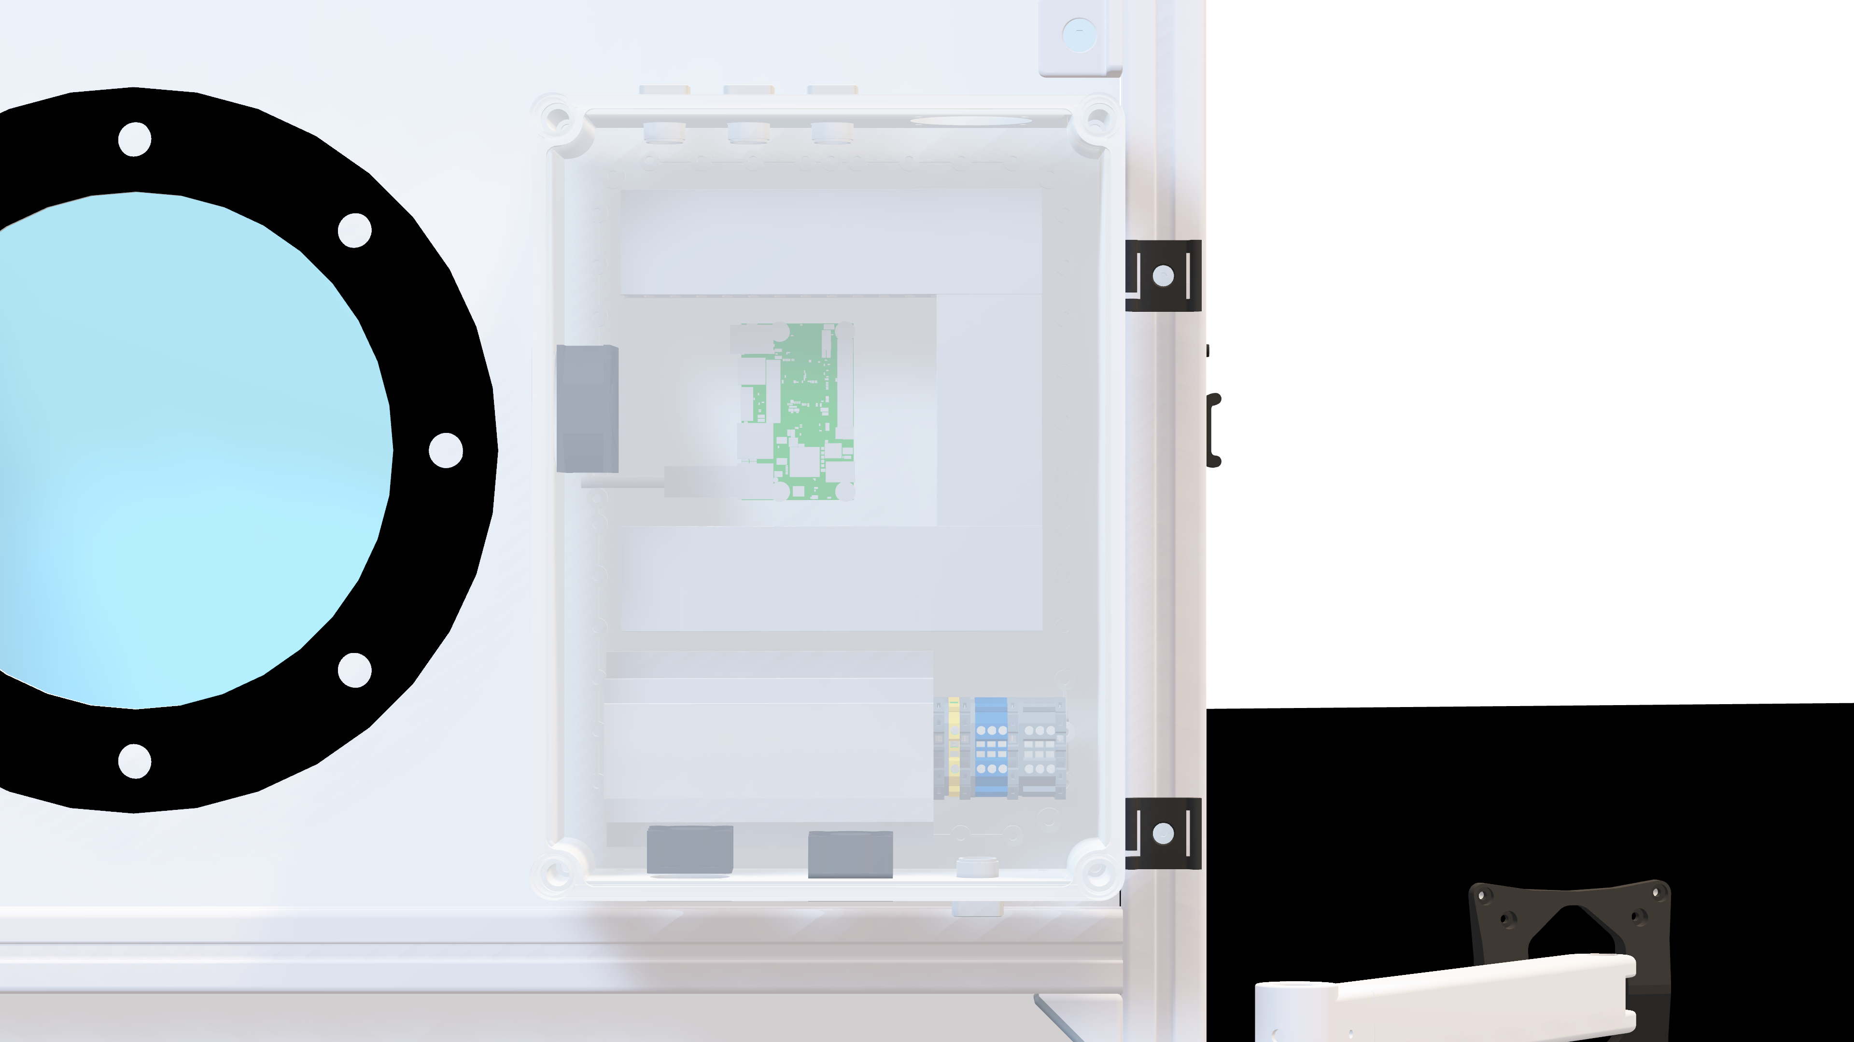
Ultra96-V2
AC/DC
Supply

Slide 8
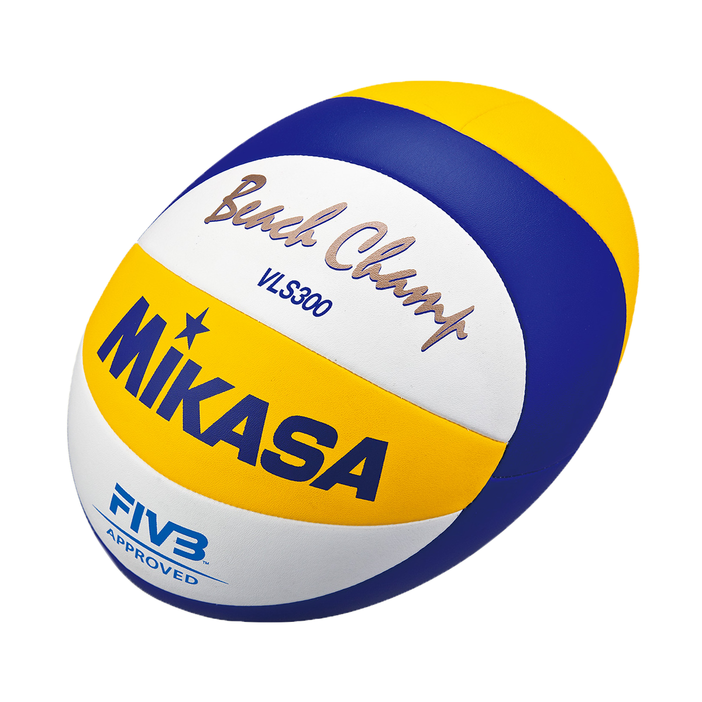
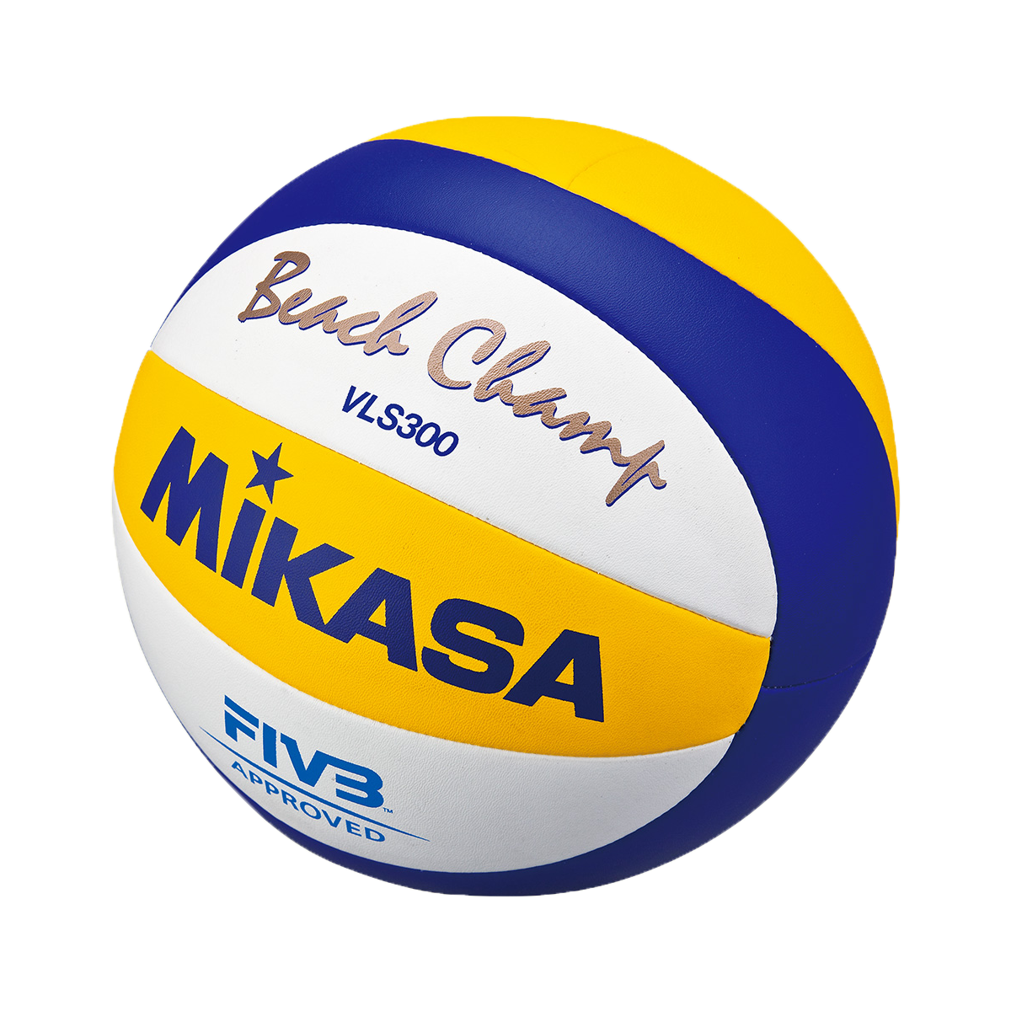
Rolling Shutter
Global Shutter
Source: mikasasport.eu

Slide 9
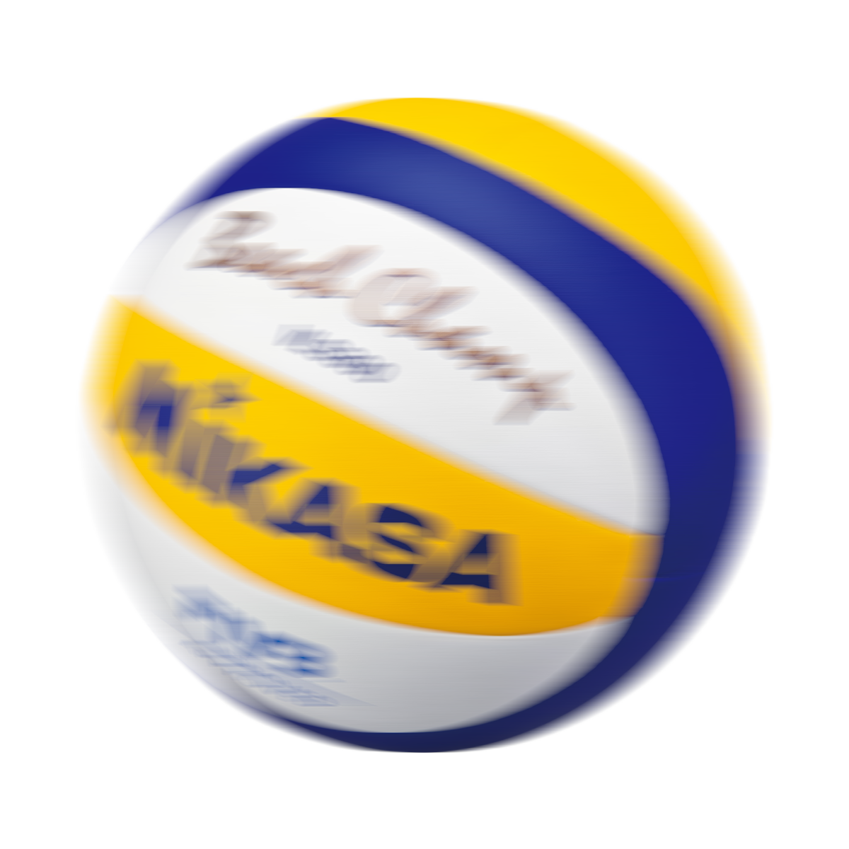

Source: mikasasport.eu

Slide 10
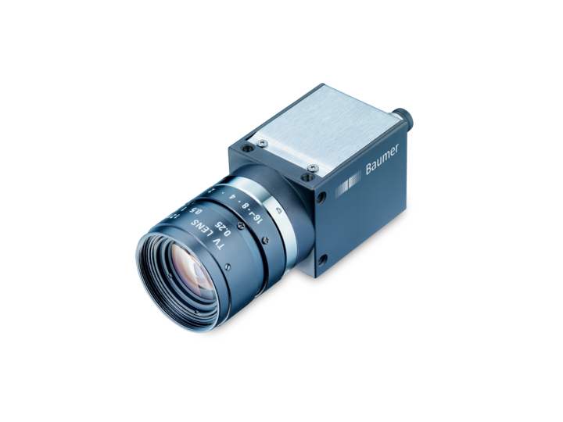
250 μs exposure time
200 fps fixed frame rate
Source: baumer.com

Slide 11
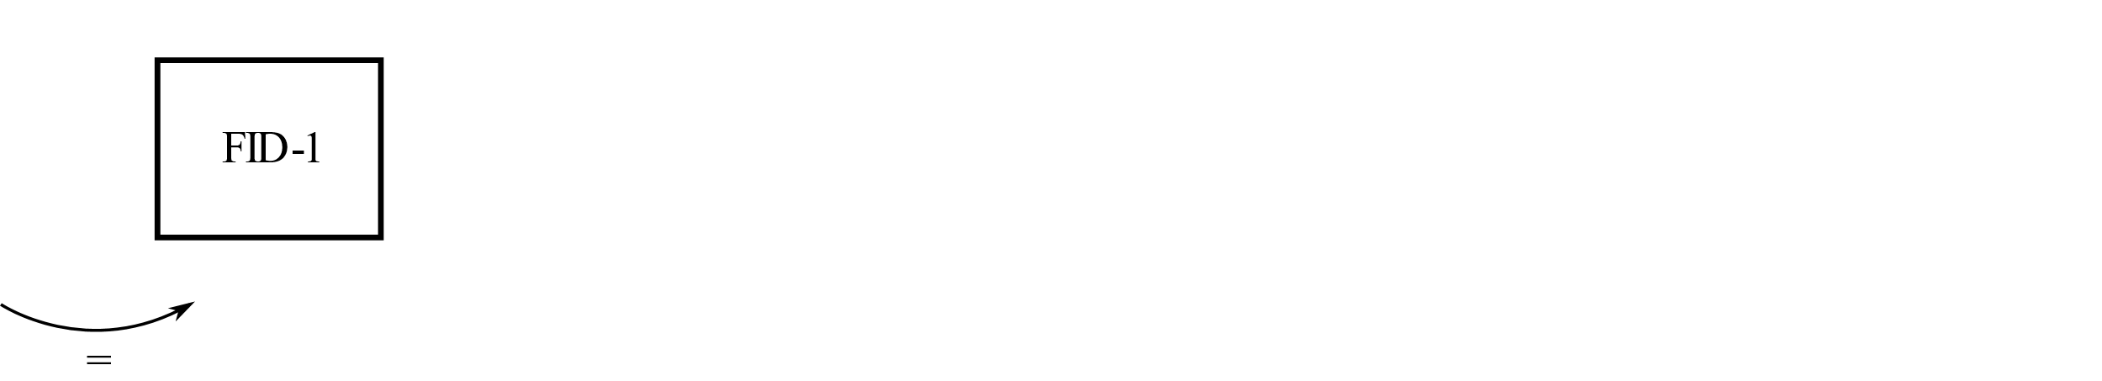




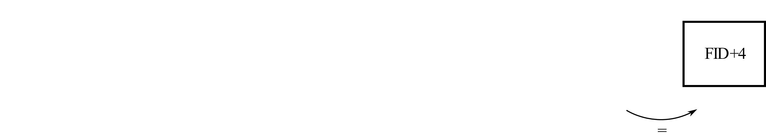

Slide 12
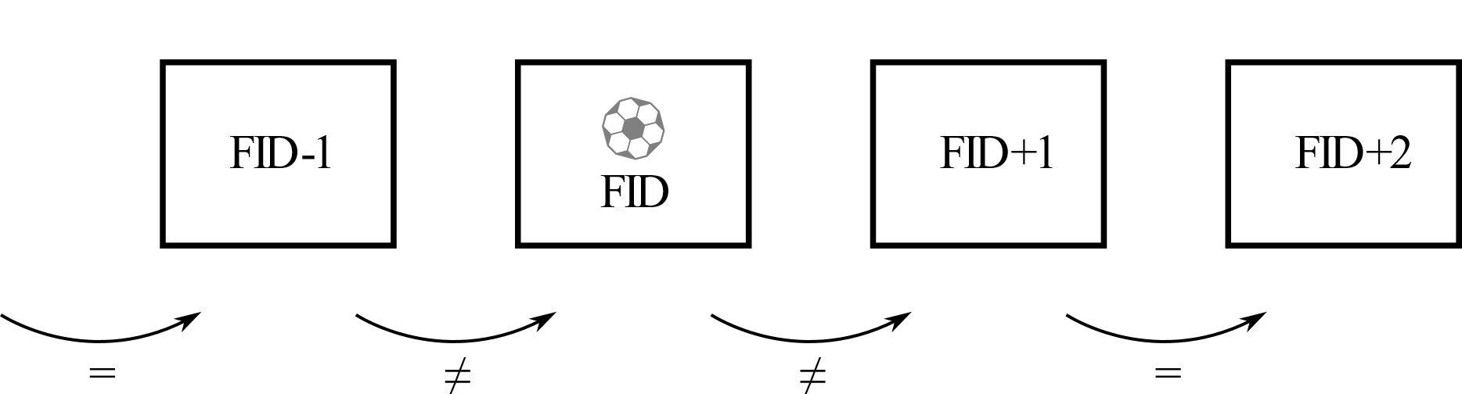

Slide 13
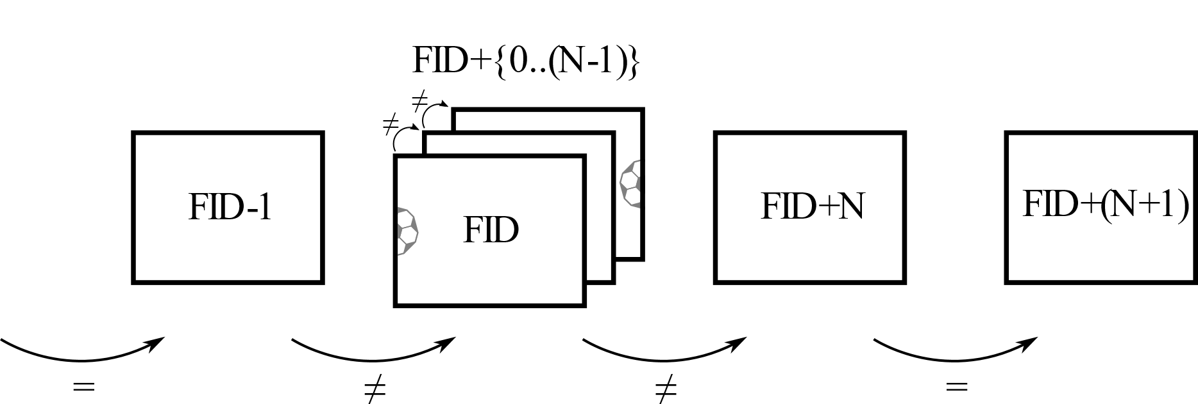

$$N∈\{1..(\text{BS}−2)\}$$

Slide 14
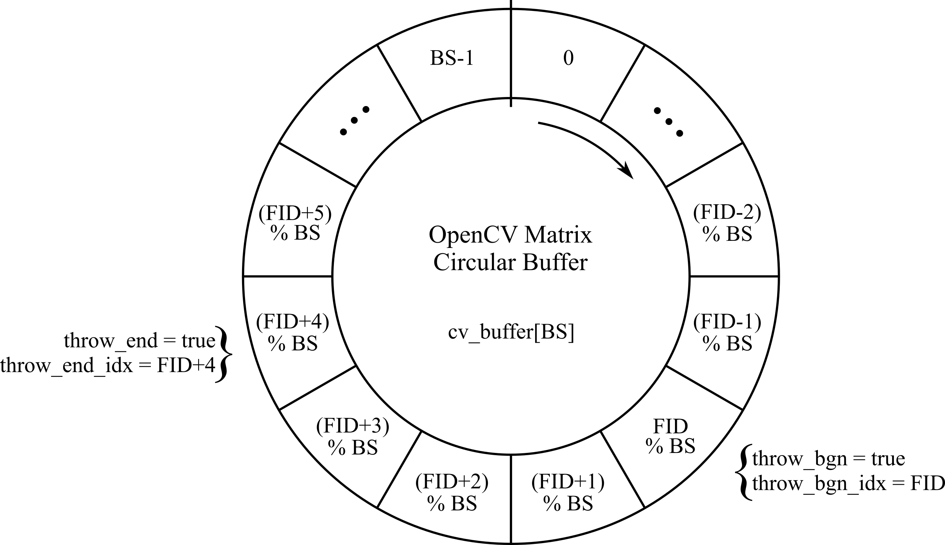
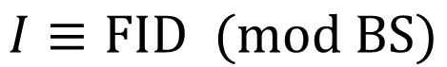
$$I≡\text{FID} (\text{mod} \text{BS})$$

Slide 15
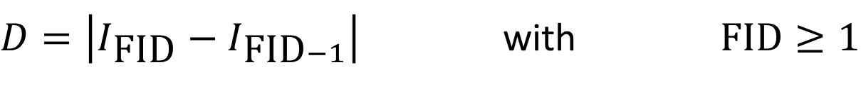
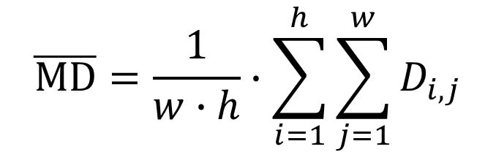
$D=\left|I_{\text{FID}}−I_{\text{FID}−1}\right|$ with $\text{FID}≥1$
$$\overline{MD}=\frac{1}{w∙h}∙\sum_{i=1}^{h}{\sum_{j=1}^{w}{D_{i,j}}}$$

Slide 16
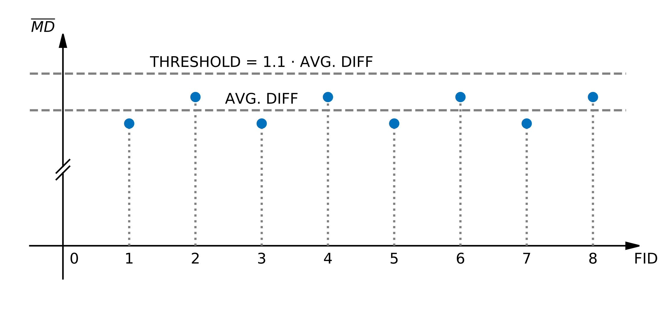

Slide 17
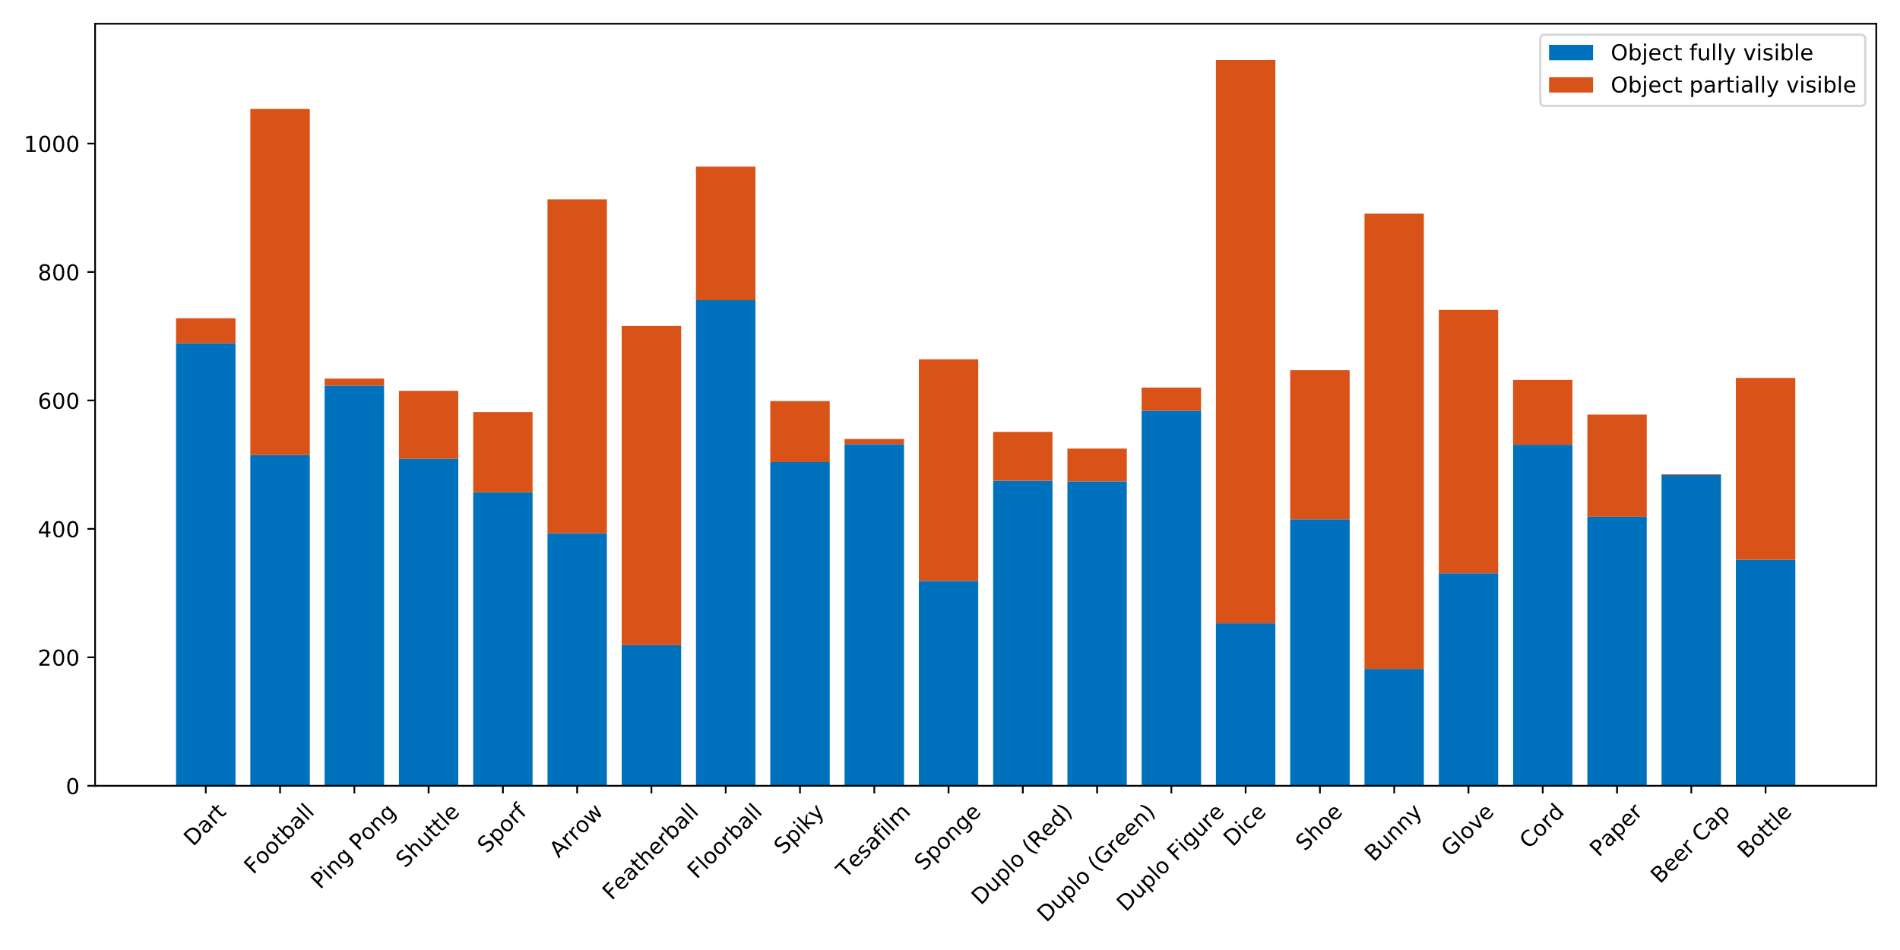

Slide 18
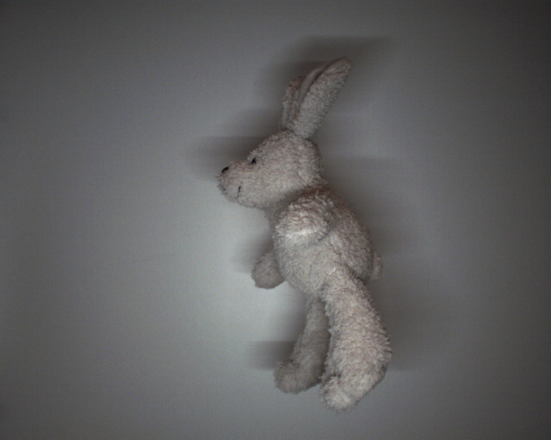
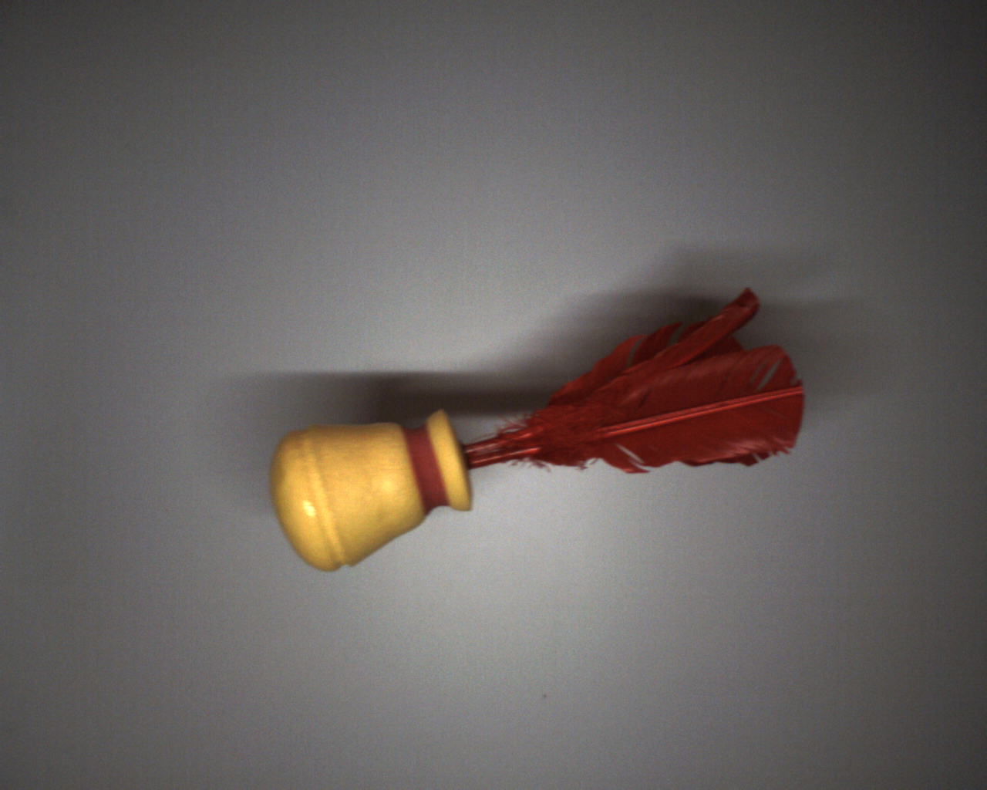
Stuffed Bunny
Hand Featherball

Slide 19
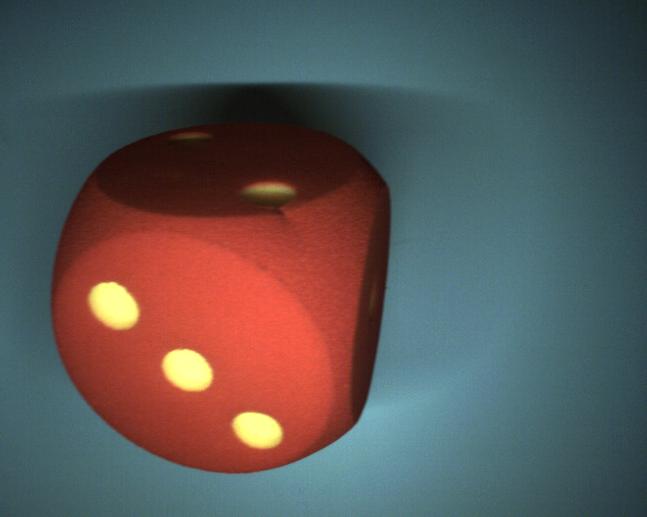
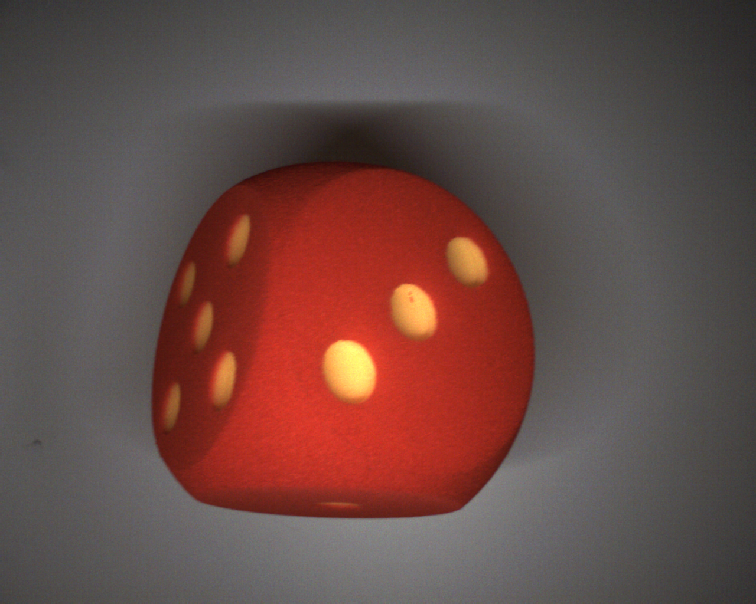
First Day
Second Day

Slide 20
CNN Architecture
Training of the CNN
Implementation on the Ultra96-V2

